Slide 1
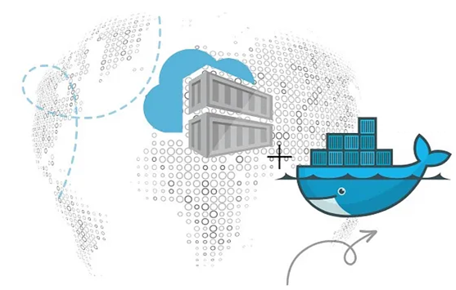
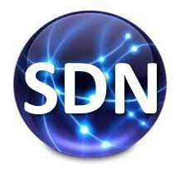
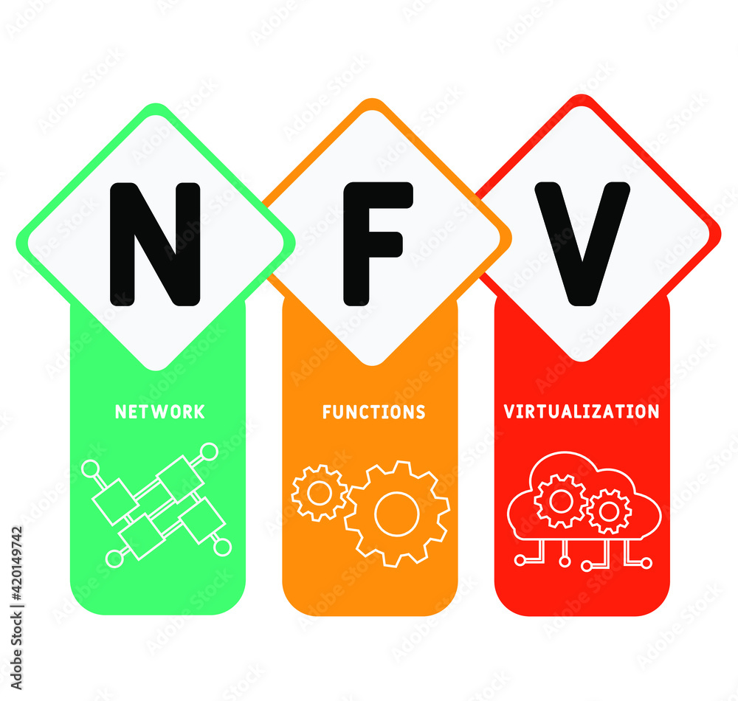
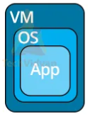
PDS
Computer Vision
OpenStack
vs
Kubernetis
AWS Roadmap
https://github.com/siagianp
https://www.youtube.com/@AmelOline/videos
https://github.com/amelcharolinesgn2/IoT_simulator-mqtt-NodeRed
https://github.com/amelcharolinesgn2/Cloud-Infrastructures
Notes:
https://roadmap.sh/aws
https://roadmap.sh/aws
https://aws.amazon.com/what-is-cloud-computing/
https://www.ibm.com/think/topics/cloud-computing
3. https://www.ibm.com/topics/cloud-computing
4. https://csrc.nist.gov/pubs/sp/800/145/final
https://csrc.nist.gov/pubs/sp/800/145/final
https://docs.openstack.org/liberty/install-guide-rdo/overview.html

Slide 2
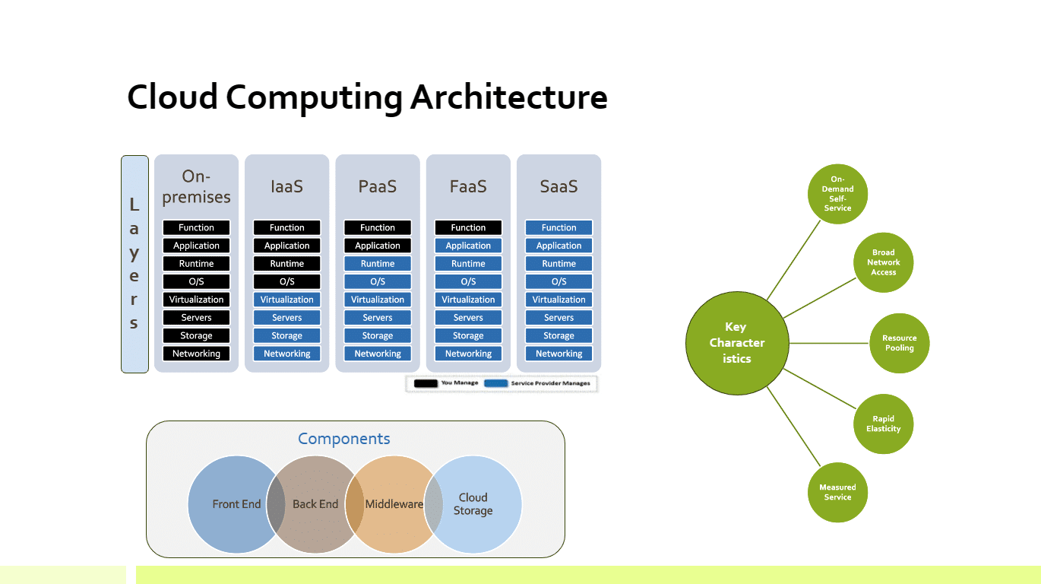
Cloud Computing Architecture
Notes:
https://garg.cc/cloud-computing-architecture-reference-architectures/
Key Characteristics of Cloud Computing Architecture:
On-Demand Self-Service: Users can provision and manage computing resources as needed without requiring human intervention from the service provider.
Broad Network Access: Cloud services are accessible over the network, promoting ubiquitous availability.
Resource Pooling: Computing resources are dynamically assigned and reassigned based on demand, serving multiple users.
Rapid Elasticity: Resources can be quickly scaled up or down to ensure optimal performance and cost efficiency.
Measured Service: Cloud systems automatically control and optimize resource usage, providing transparency for both the provider and the consumer.
Layers of Cloud Computing Architecture:
Infrastructure as a Service (IaaS): Virtualized computing resources are offered over the internet, including virtual machines, storage, and networking.
Platform as a Service (PaaS): A platform for developing, running, and managing applications without dealing with infrastructure complexities.
Software as a Service (SaaS): Software applications are delivered over the internet on a subscription basis.
Function as a Service (FaaS): Serverless computing allows developers to run individual functions in response to events without managing servers.
Components of Cloud Computing Architecture:
Front End: The user interface and client-side applications that interact with the cloud service.
Back End: Cloud infrastructure comprising servers, storage, databases, and other components.
Middleware: Facilitates communication and data management between the front end and back end.
Cloud Storage: Centralized storage system for storing and retrieving data over the internet.
Navigating the Cloud Landscape with Reference Architectures:
What are Cloud Computing Reference Architectures?
Cloud computing reference architectures serve as blueprints for building cloud-based solutions. They define the core components, services, and deployment models, providing a common language for organizations and stakeholders. Two main types exist: open and proprietary.
ConsiderationProprietaryOpenVendor lock-inHighLowSpecificityHighLowSupportHighLowFlexibilityLowHighCostHighLowRiskHighLowProprietary vs Open Cloud Computing Reference Architecture

Slide 3
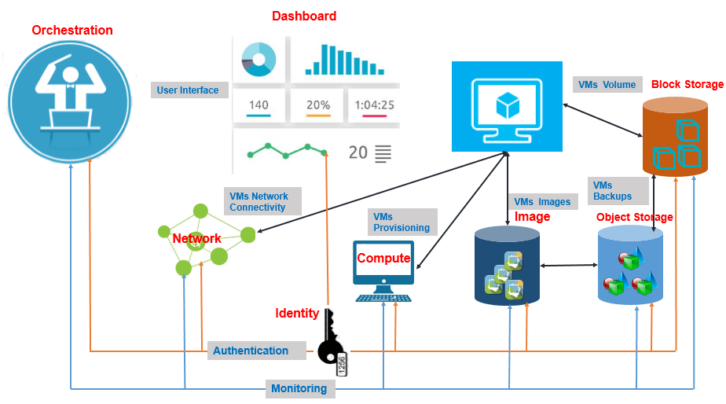
Deployment Models
Notes:
https://www.techplayon.com/openstack-openstack-component-and-its-deployment-models/

Slide 4
OpenStack

Slide 5
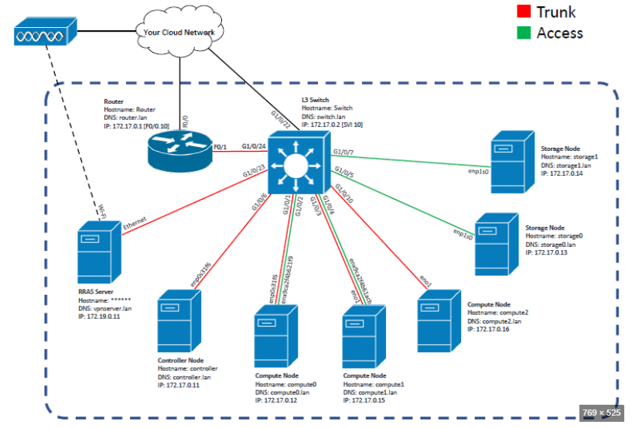
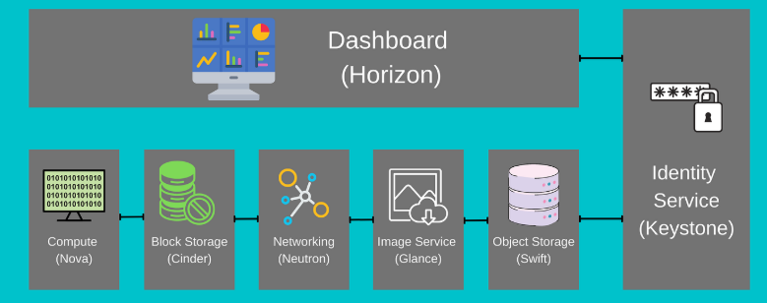
Notes:
https://www.opensourceforu.com/2023/07/building-a-private-cloud-using-openstack/

Slide 6
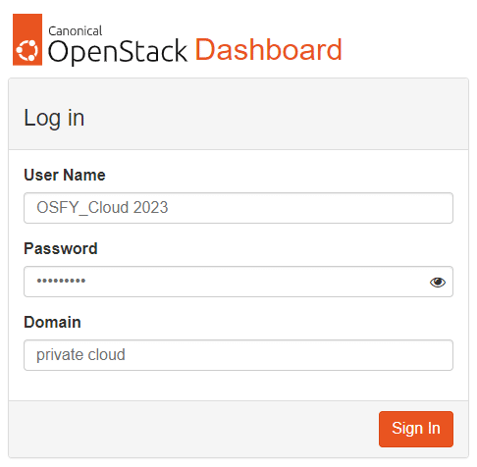
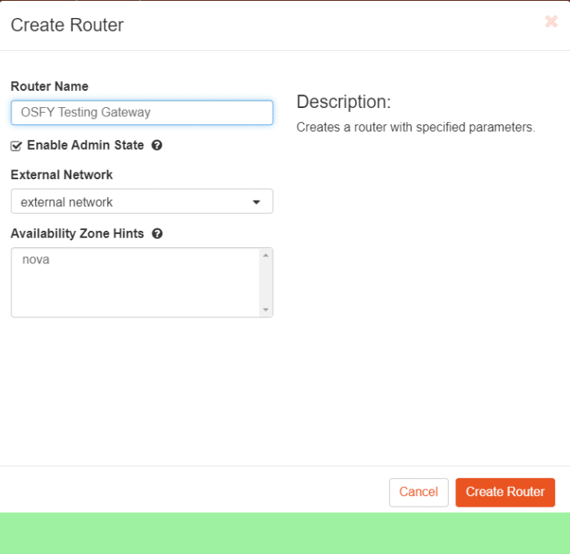
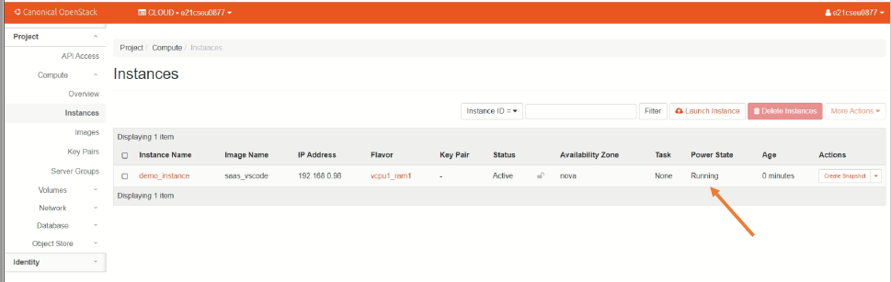
Table 1: Minimum hardware requirements to set up OpenStack
Component CPU (cores) RAM Storage hard disk Number of NICs
Controller node Dual-core processor 8GB 100GB 2 NICs
Compute node Dual-core processor 8GB 100GB 2 NICs
Block storage node Dual-core processor 4GB 100GB 1 NIC
Object storage node Dual-core processor 4GB 100GB 1 NIC
OpenStack services:
$ sudo systemctl enable apache2
$ sudo systemctl start apache2
$ sudo systemctl enable memcached
$ sudo systemctl start memcached
$ sudo systemctl enable uwsgi
$ sudo systemctl start uwsgi
$ sudo systemctl enable horizon
$ sudo systemctl start horizon
Notes:
https://www.opensourceforu.com/2023/07/building-a-private-cloud-using-openstack/

Slide 7
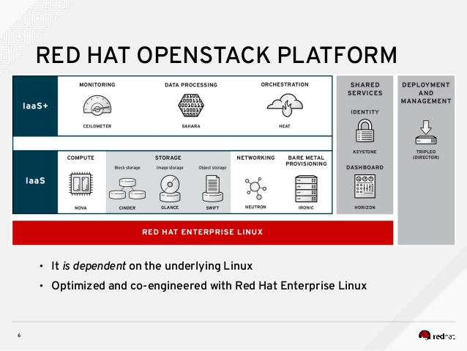
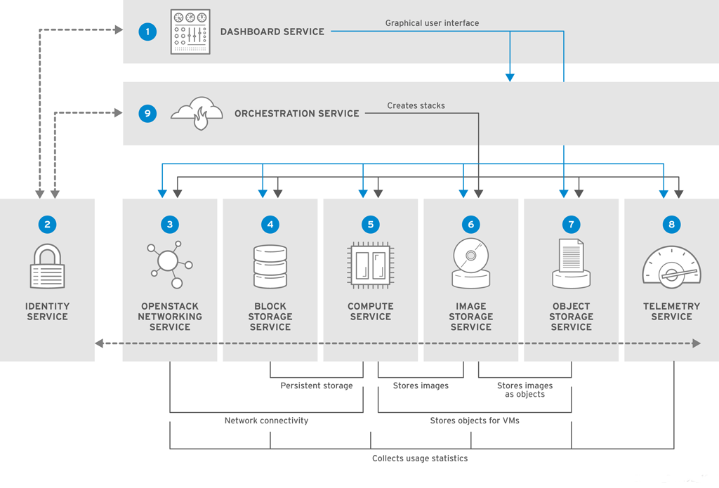
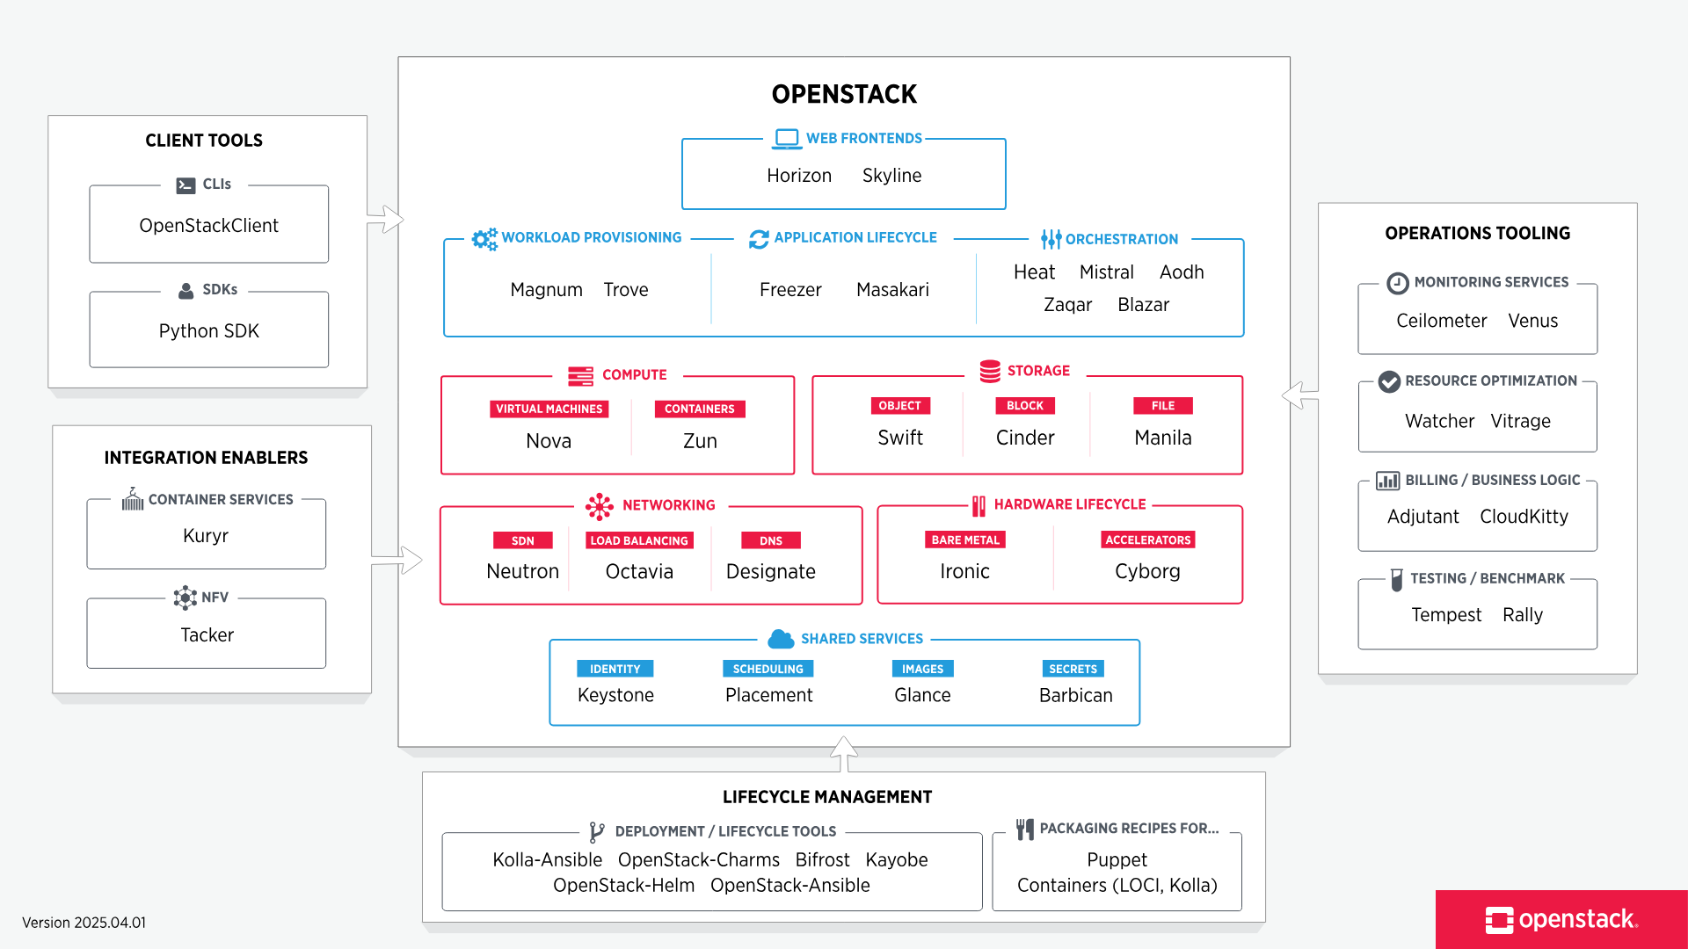
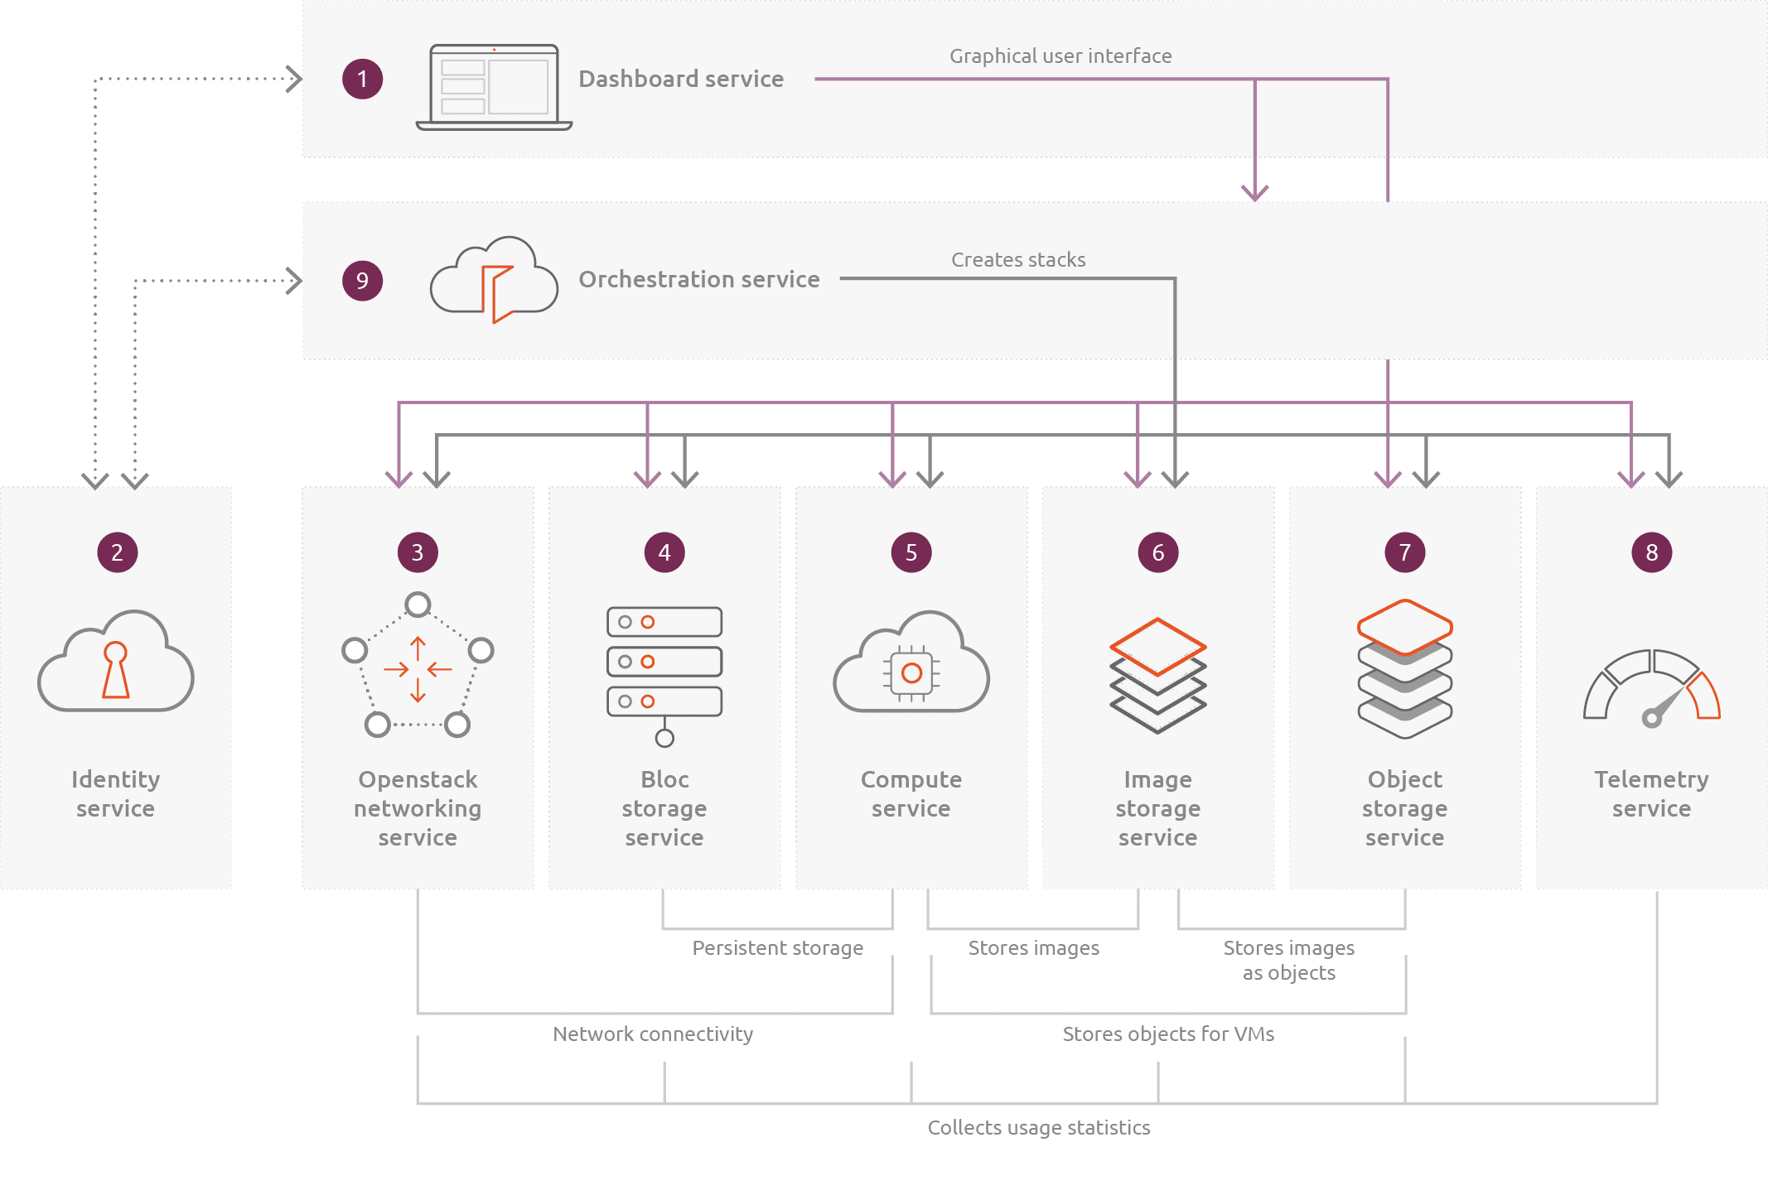
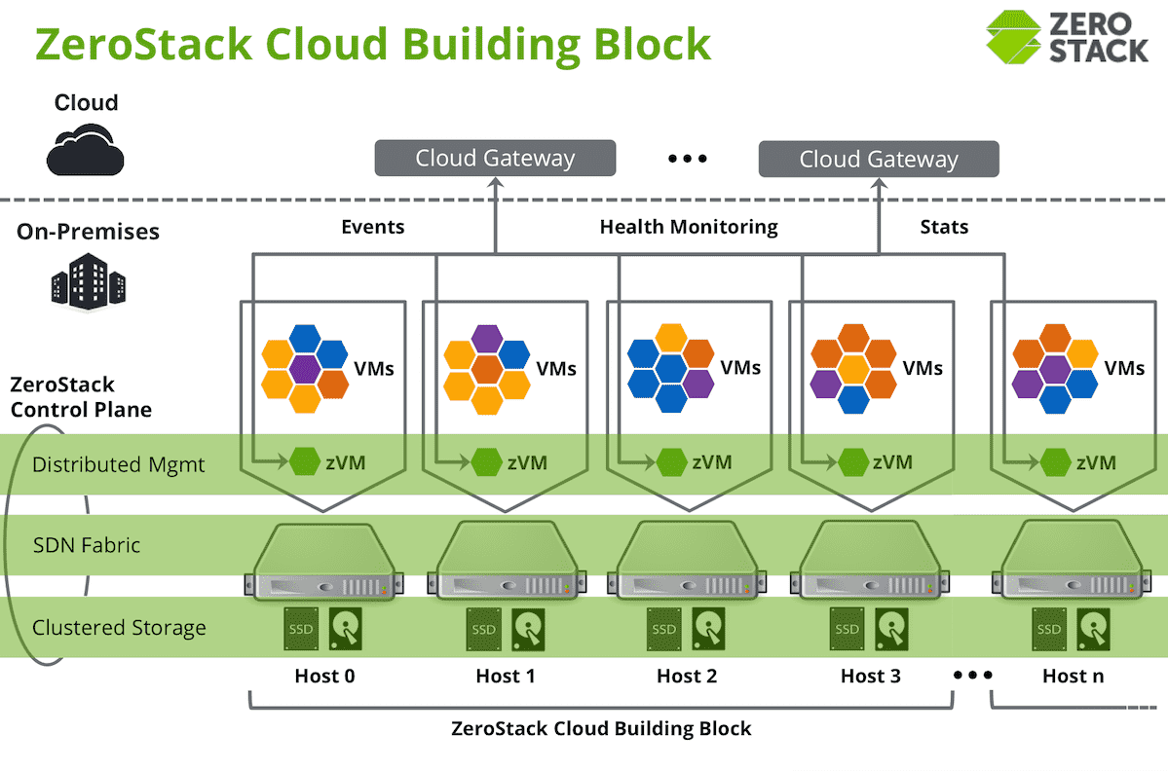
Notes:
https://www.openstack.org/software/
https://serverfault.com/questions/1050959/do-all-servers-have-one-base-os-like-in-red-hat-openstack-architecture

Slide 8
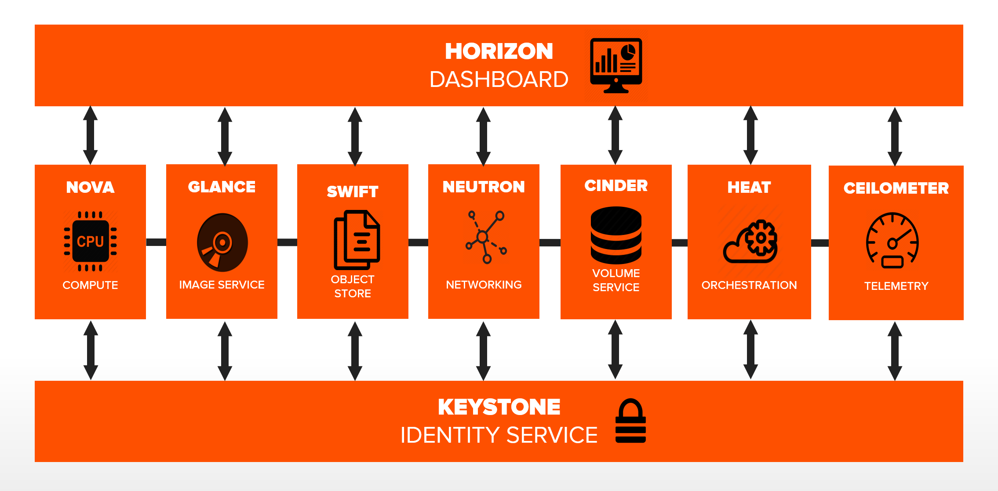
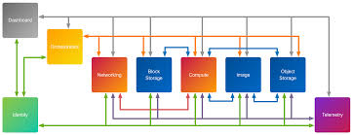
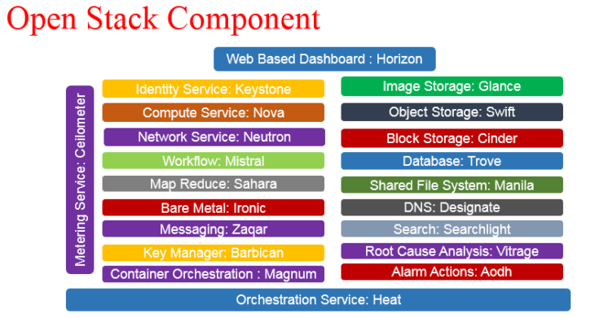
OpenStack Architecture
OpenStack Cloud Architecture- Conceptual and Logical architecture
Notes:
https://www.youtube.com/watch?v=xbm6LGunOzY
https://pure-storage-openstack-docs.readthedocs.io/en/zed_a/openstack-overview/section_modular-collection.html
https://www.techplayon.com/openstack-openstack-component-and-its-deployment-models/
https://blog.nashtechglobal.com/openstack-introduction-and-its-installation/

Slide 9
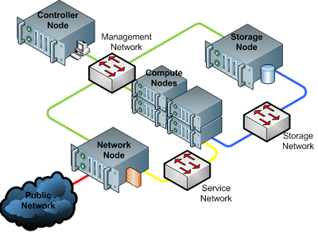
Cloud infrastructure (compute, network, storages, neutron swift,Heat)
Compute (Nova) · Storage (Cinder, Swift, Manila) · Networking (Neutron) · Identity Management (Keystone)
OpenStack services
Service | Project name | Description
Dashboard | Horizon | Provides a web-based self-service portal to interact with underlying OpenStack services, such as launching an instance, assigning IP addresses and configuring access controls.
Compute | Nova | Manages the lifecycle of compute instances in an OpenStack environment. Responsibilities include spawning, scheduling and decommissioning of virtual machines on demand.
Networking | Neutron | Enables Network-Connectivity-as-a-Service for other OpenStack services, such as OpenStack Compute. Provides an API for users to define networks and the attachments into them. Has a pluggable architecture that supports many popular networking vendors and technologies.
 |  | Storage
Object Storage | Swift | Stores and retrieves arbitrary unstructured data objects via a RESTful, HTTP based API. It is highly fault tolerant with its data replication and scale-out architecture. Its implementation is not like a file server with mountable directories. In this case, it writes objects and files to multiple drives, ensuring the data is replicated across a server cluster.
Block Storage | Cinder | Provides persistent block storage to running instances. Its pluggable driver architecture facilitates the creation and management of block storage devices.
 |  | Shared services
Identity service | Keystone | Provides an authentication and authorization service for other OpenStack services. Provides a catalog of endpoints for all OpenStack services.
Image service | Glance | Stores and retrieves virtual machine disk images. OpenStack Compute makes use of this during instance provisioning.
Telemetry | Ceilometer | Monitors and meters the OpenStack cloud for billing, benchmarking, scalability, and statistical purposes.
 |  | Higher-level services
Orchestration | Heat | Orchestrates multiple composite cloud applications by using either the native HOT template format or the AWS CloudFormation template format, through both an OpenStack-native REST API and a CloudFormation-compatible Query API.
Notes:
https://docs.openstack.org/liberty/install-guide-rdo/overview.html
https://docs.openstack.org/liberty/install-guide-rdo/overview.html

Slide 10
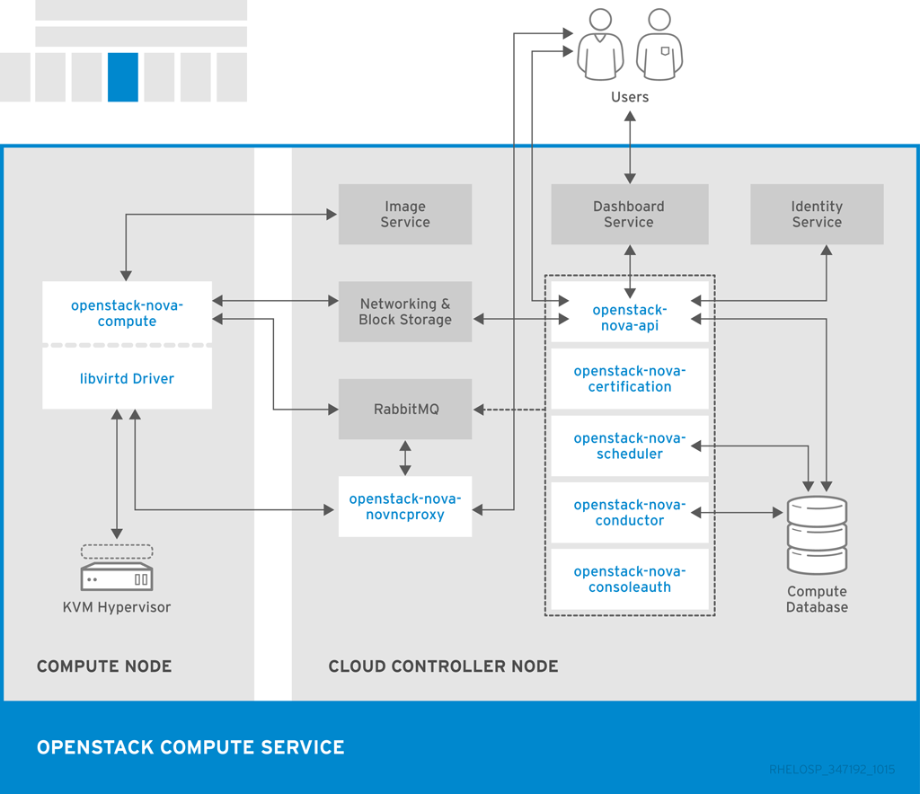
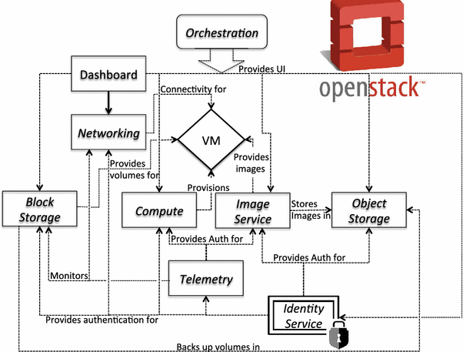
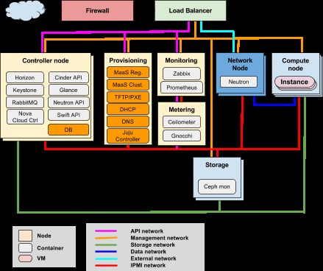
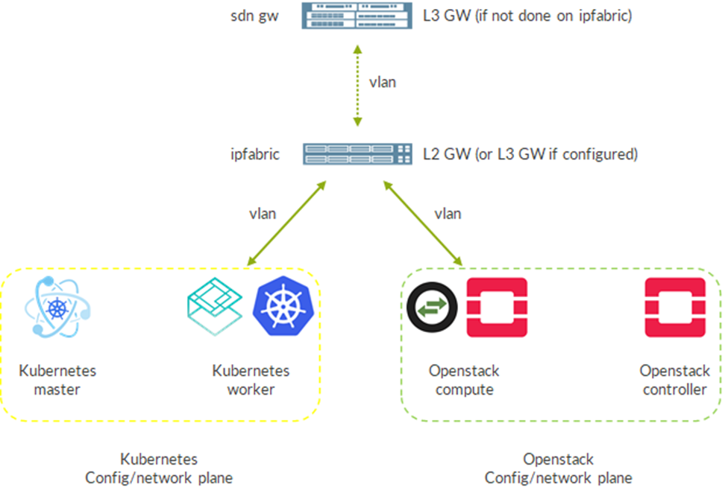
Notes:
Architecture Guide | Red Hat OpenStack Platform | 10 | Red Hat

Slide 11
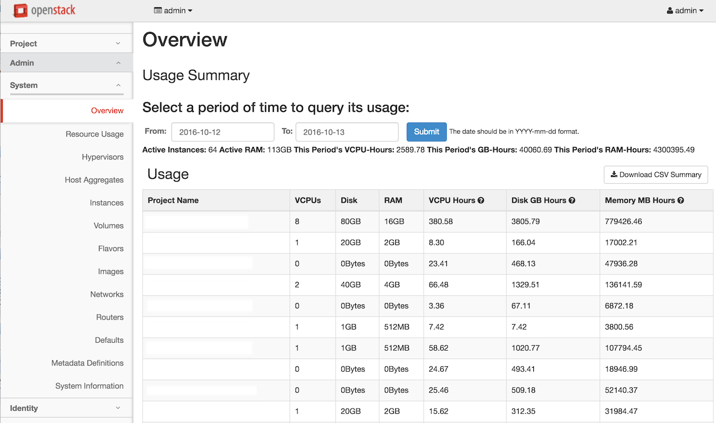
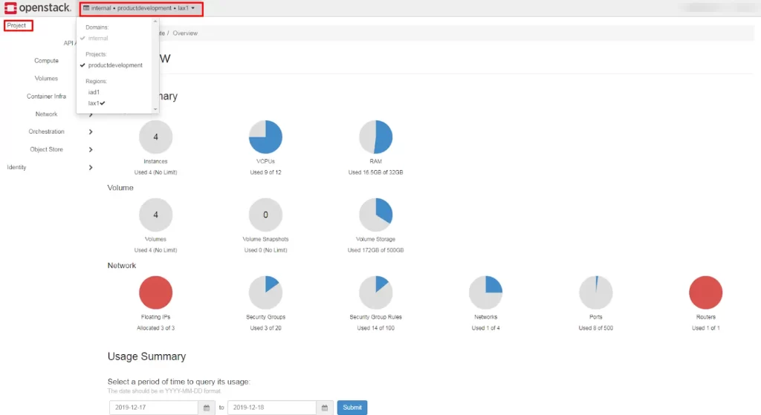
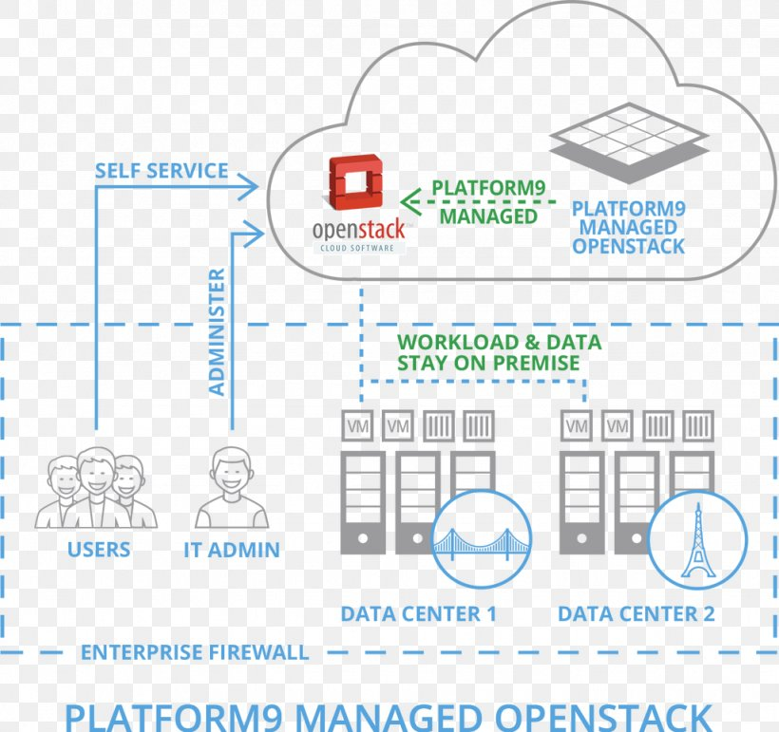
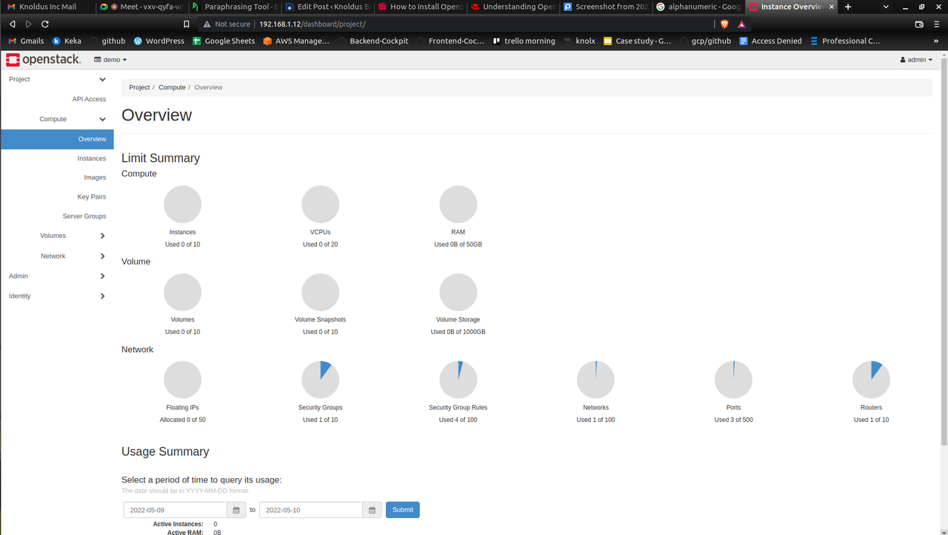
Platform Managed Openstack
Notes:
https://blog.nashtechglobal.com/openstack-introduction-and-its-installation/
https://openmetal.io/docs/glossary/what-is-openstack-horizon/
https://docs.openstack.org/ocata/admin-guide/common/get-started-dashboard.html
Compute, Volumes, Container Infra, Network, Orchestration and Object Store.
The Compute tab contains the following views and options:
Overview allows you to view reports for the project.
Instances allow you to view and launch an instance. You can also create an instance from a snapshot and stop, pause, or reboot instances.
Images allow you to view images and instance snapshots, as well as images that are publicly available. You can launch instances from images and snapshots, and create edit, and delete images.
Key Pairs allow you to view, create, edit, import, and delete key pairs.
Server Groups allow a server group to be assigned to launch the instance.
The Volumes tab contains the following views and options:
Volumes allows you to view, create, edit, and delete volumes.
Backups allow you to view, create, edit, and delete backups.
Snapshots allow you to view, create, edit, and delete volume snapshots.
Groups allow you to view, create, edit, and delete consistency groups.
Group Snapshots allow you to view, create, edit, and delete consistency group snapshots.
The Container Infra tab contains the following views and options:
Clusters allow you to view, create and manage clusters.
Cluster Templates allow you to view, create and manage clusters templates.
The Network tab contains the following views and options:
Network Topology allows you to view the network topology.
Networks allows you to create and manage public and private networks.
Routers allow you to create and manage routers.
Security Groups allow you to view, create, edit, and delete security groups and security group rules.
Floating IPs allows you to assign an IP address to or release it from a project.
The Orchestration tab contains the following views and options:
Stacks allow the create and launch of stacks.
Resource Types allow you to view the resources available for orchestration.
Template Versions allow you to view the created and available templates.
Template Generator allows you to create templates.
The Object Store tab contains the following views and options:
Containers allow you to create and manage containers and objects.

Slide 12
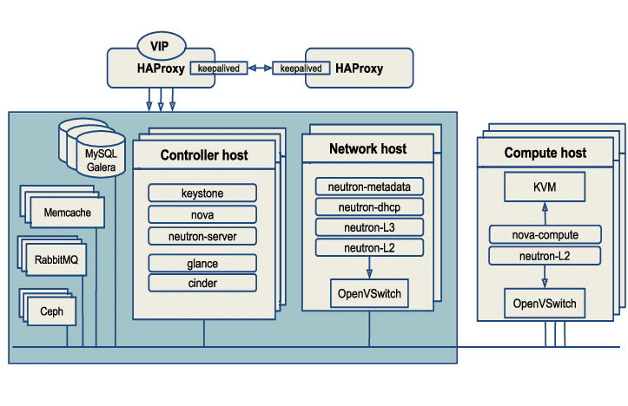
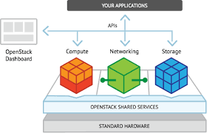
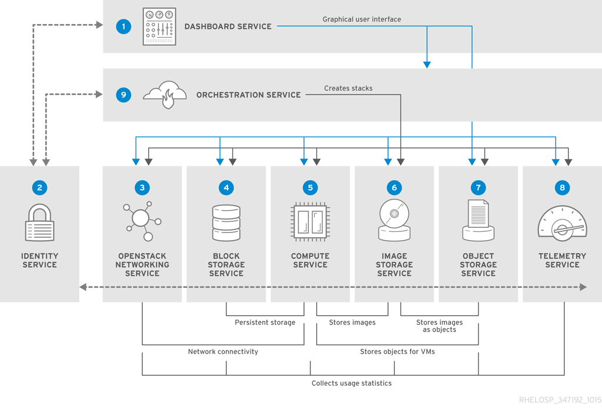
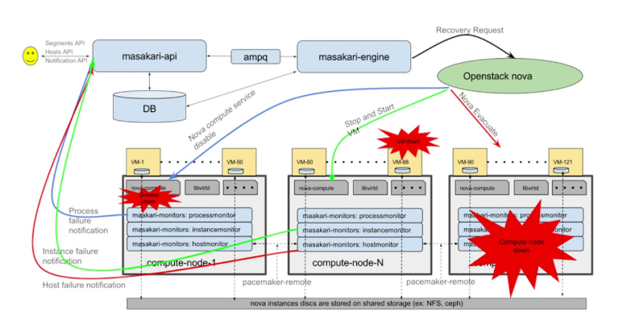
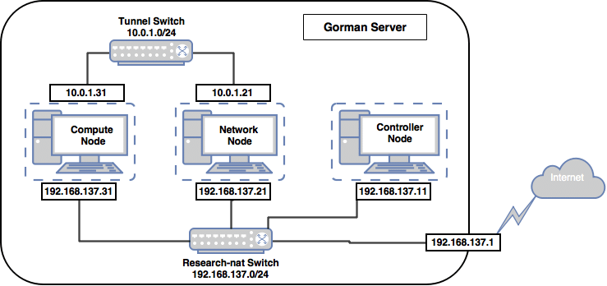
Notes:
OpenStack richtig nutzen: Tipps für den Betrieb ohne .
https://blog.nashtechglobal.com/openstack-introduction-and-its-installation/

Slide 13
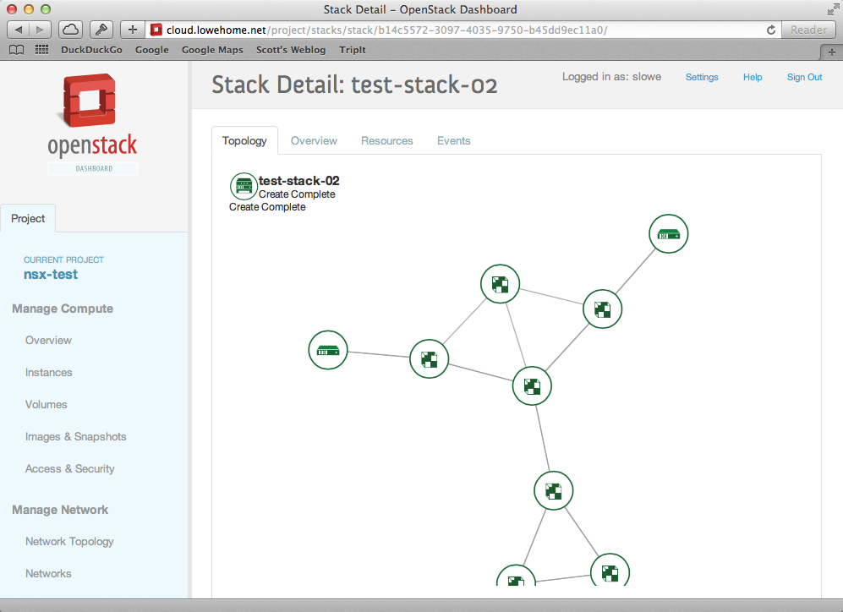
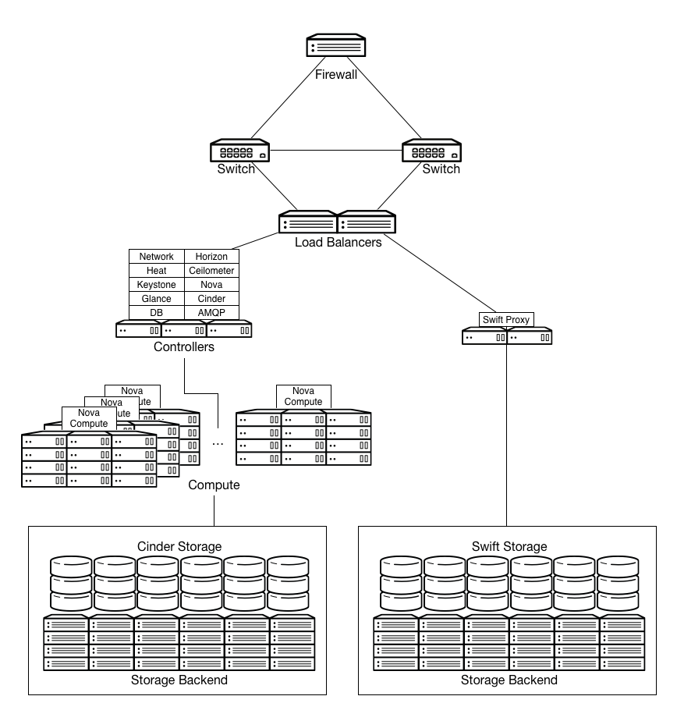
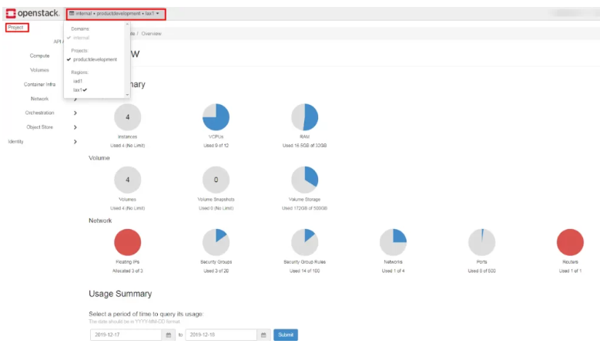
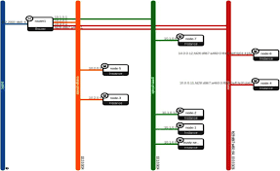
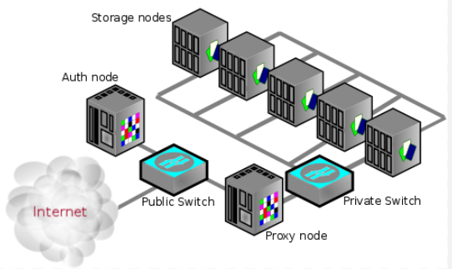
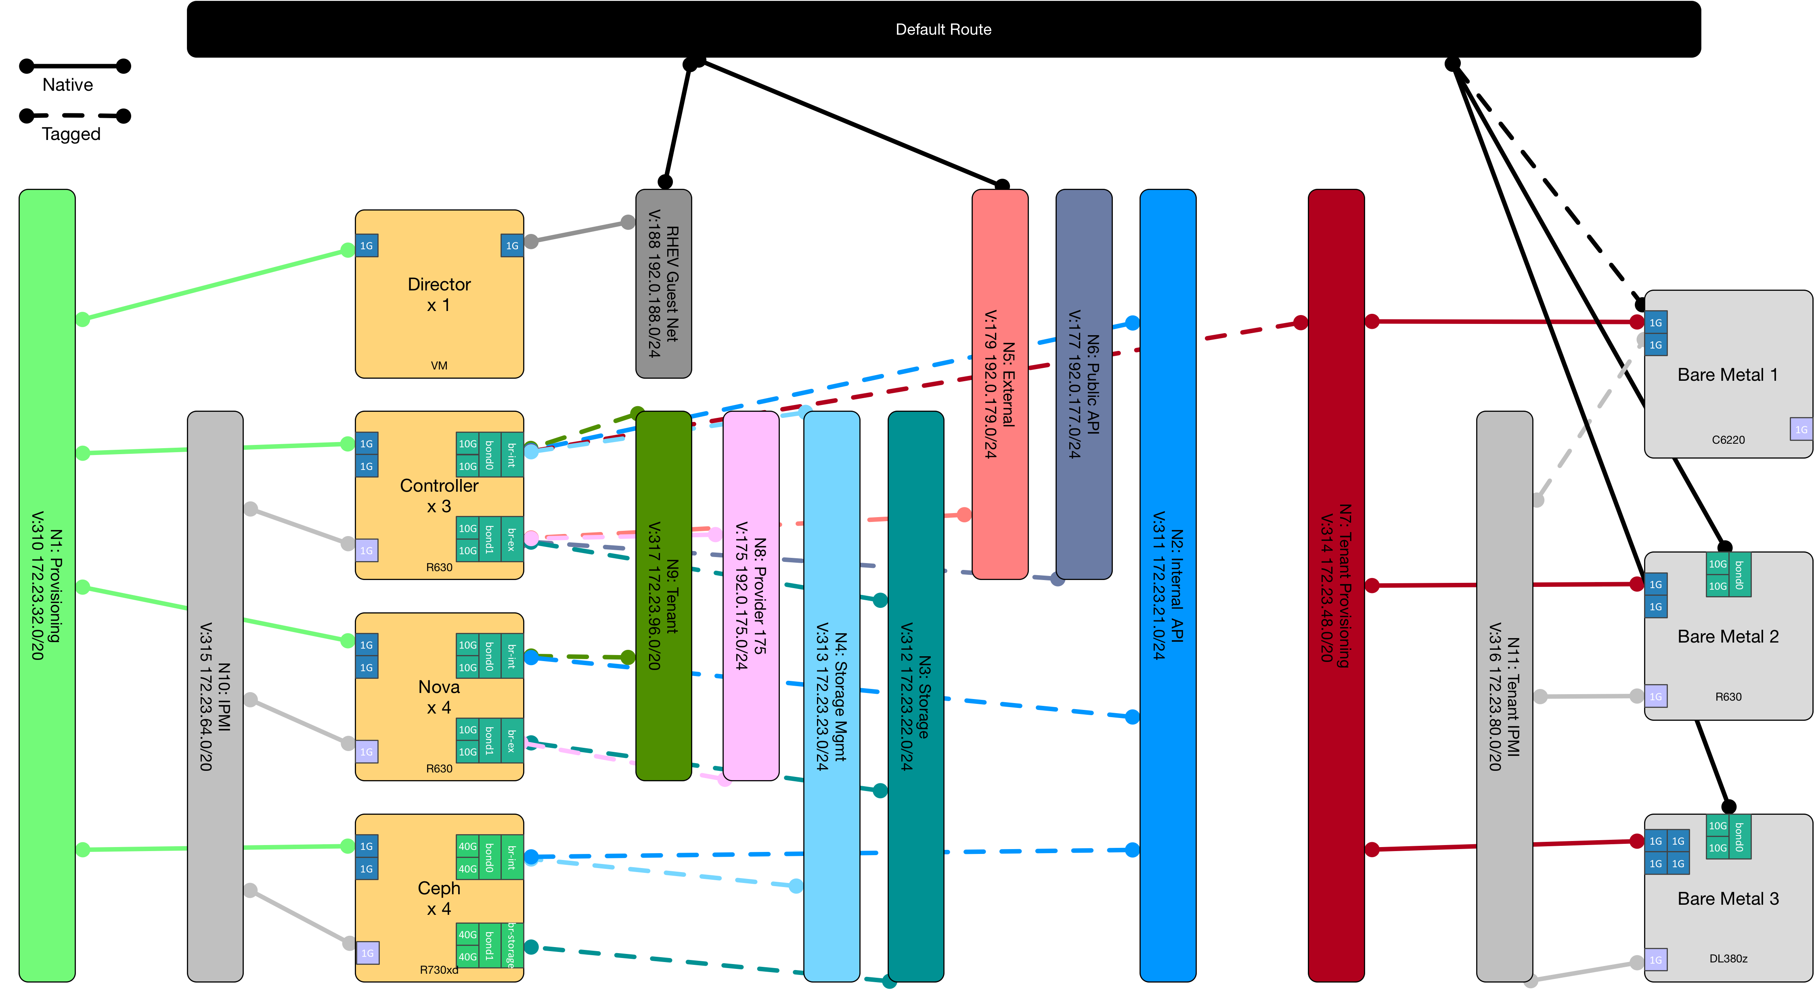
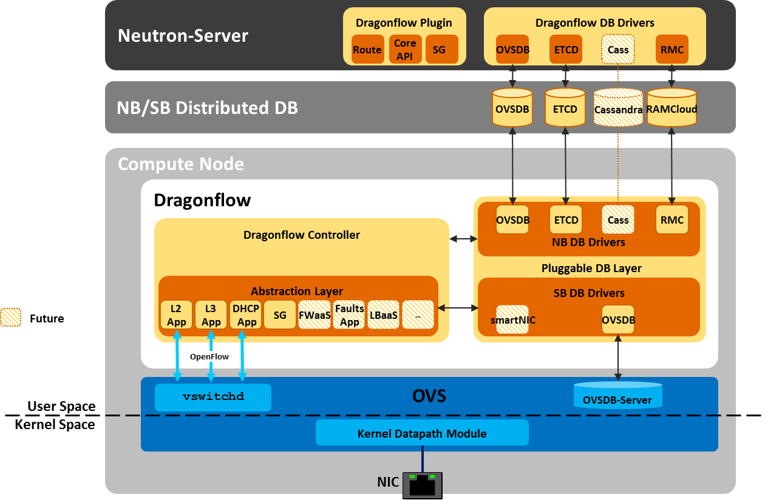
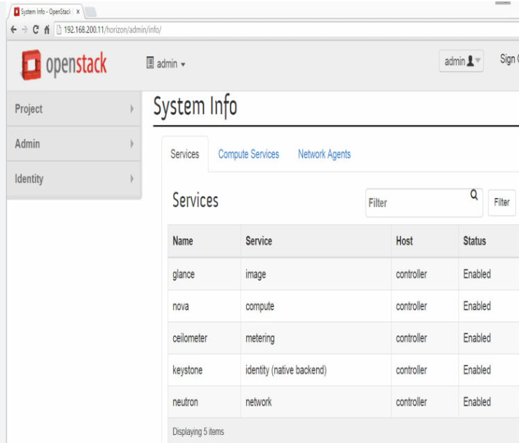
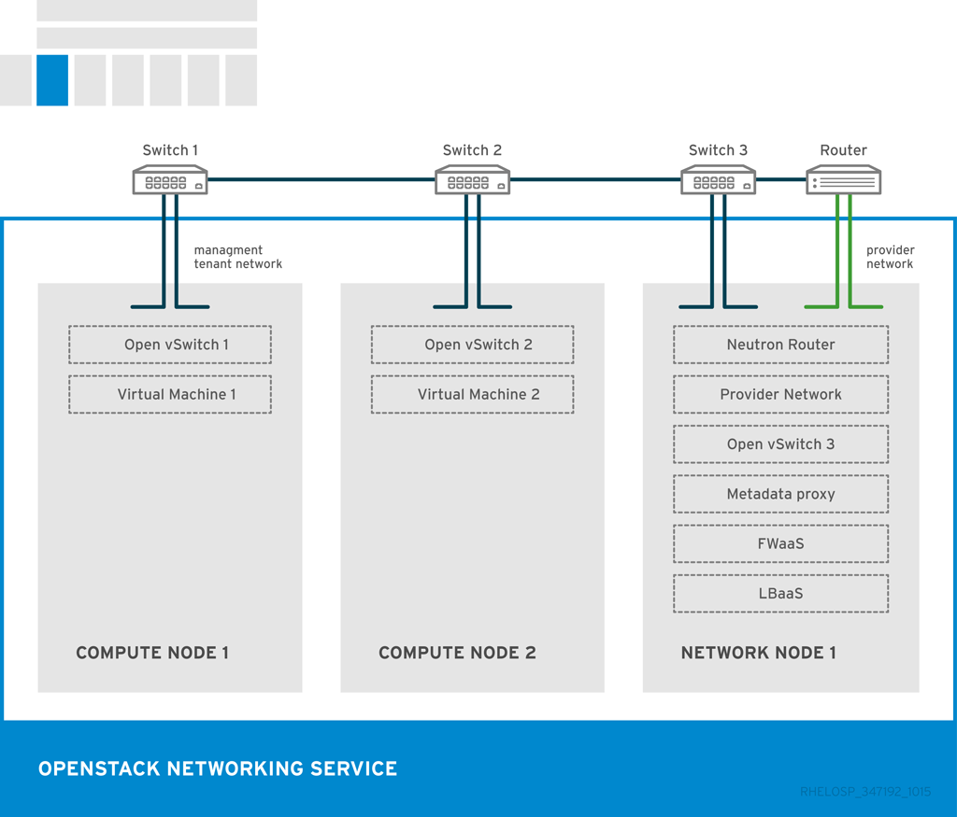
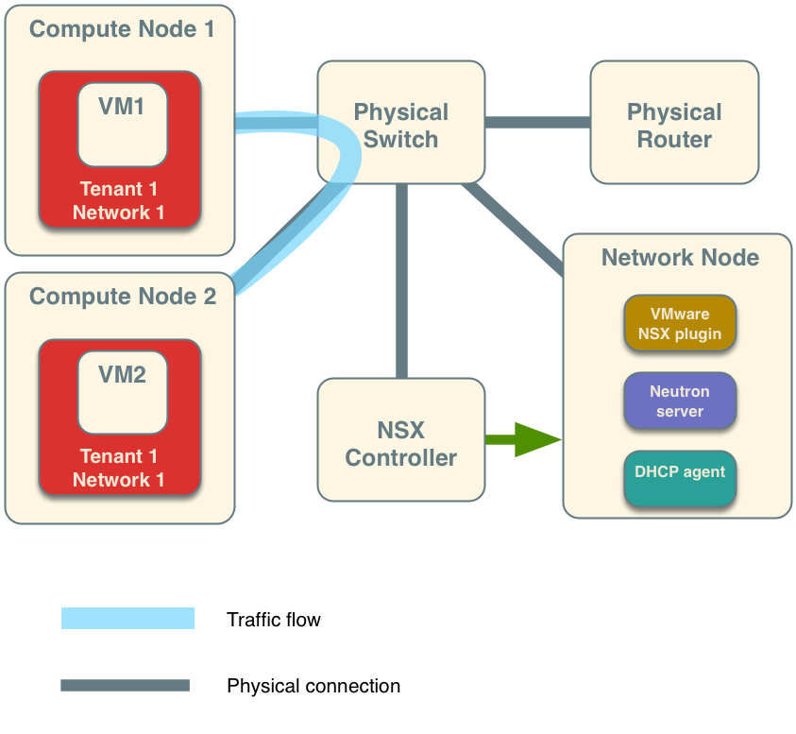
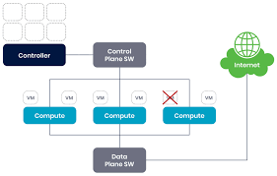
Neutron
Compute
Controller
Object Storage
Dasboard
Notes:
Neutron : https://guifreelife.com/blog/2017/08/14/OpenStack-Network-Diagram/
https://docs.redhat.com/es/documentation/red_hat_openstack_platform/10/html-single/architecture_guide/index
Compute: General compute cloud — arch-design 0.0.1.dev22 documentation
Controller : https://docs.spectrocloud.com/clusters/data-center/openstack/
https://people.csail.mit.edu/jon/openstack-ops/content/example_architecture.html
https://www.packtpub.com/en-us/product/openstack-cloud-computing-cookbook-fourth-edition-9781788398763/chapter/neutron-openstack-networking-4/section/introduction-to-openstack-networking-ch04lvl1sec45

Slide 14
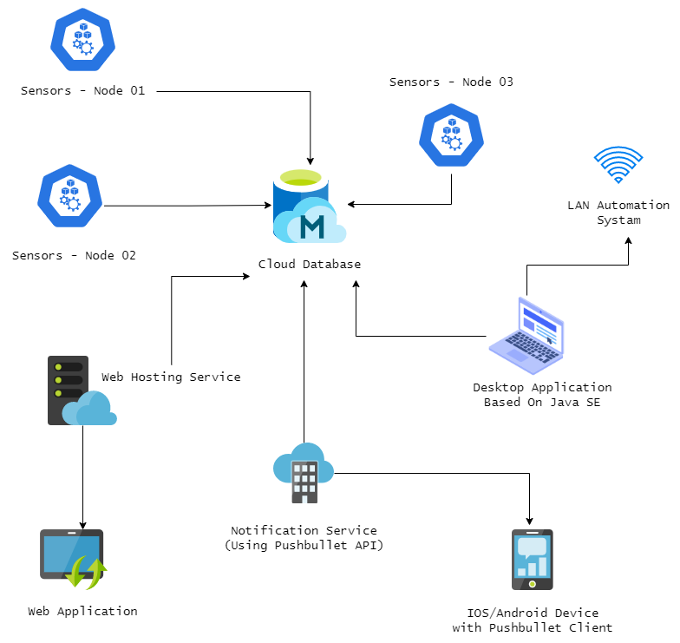

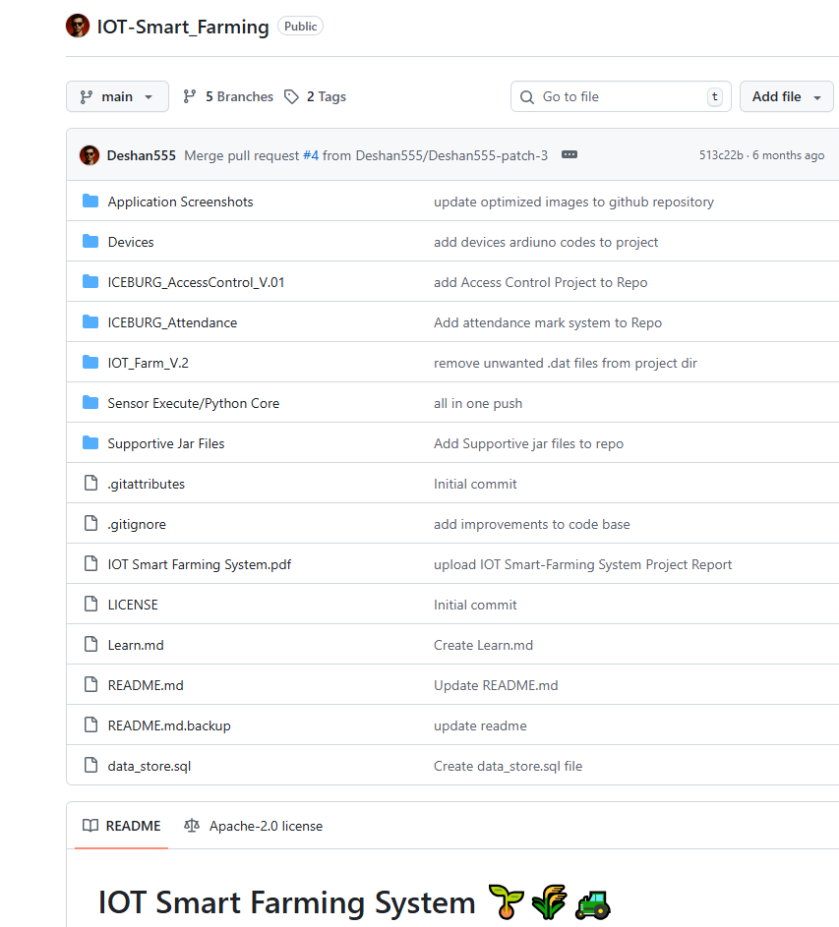
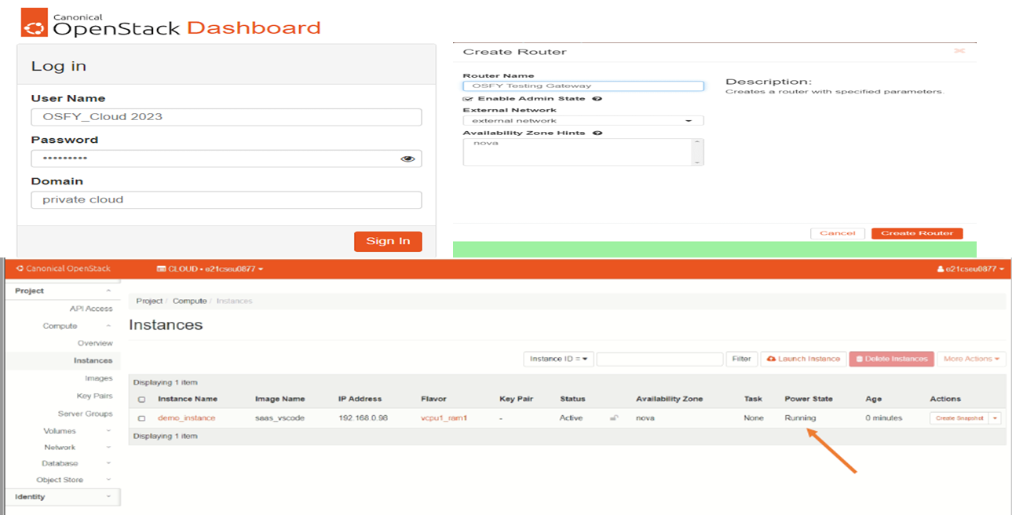
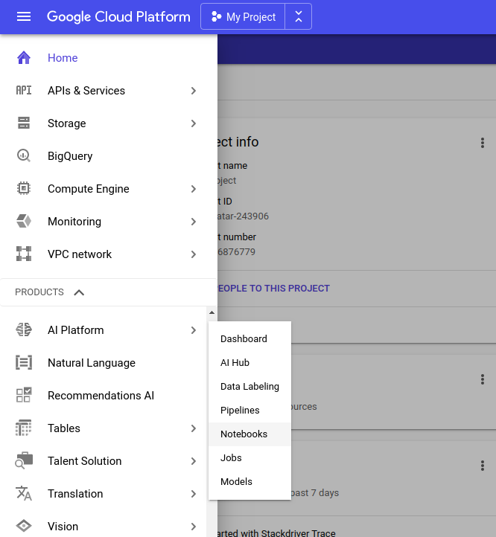
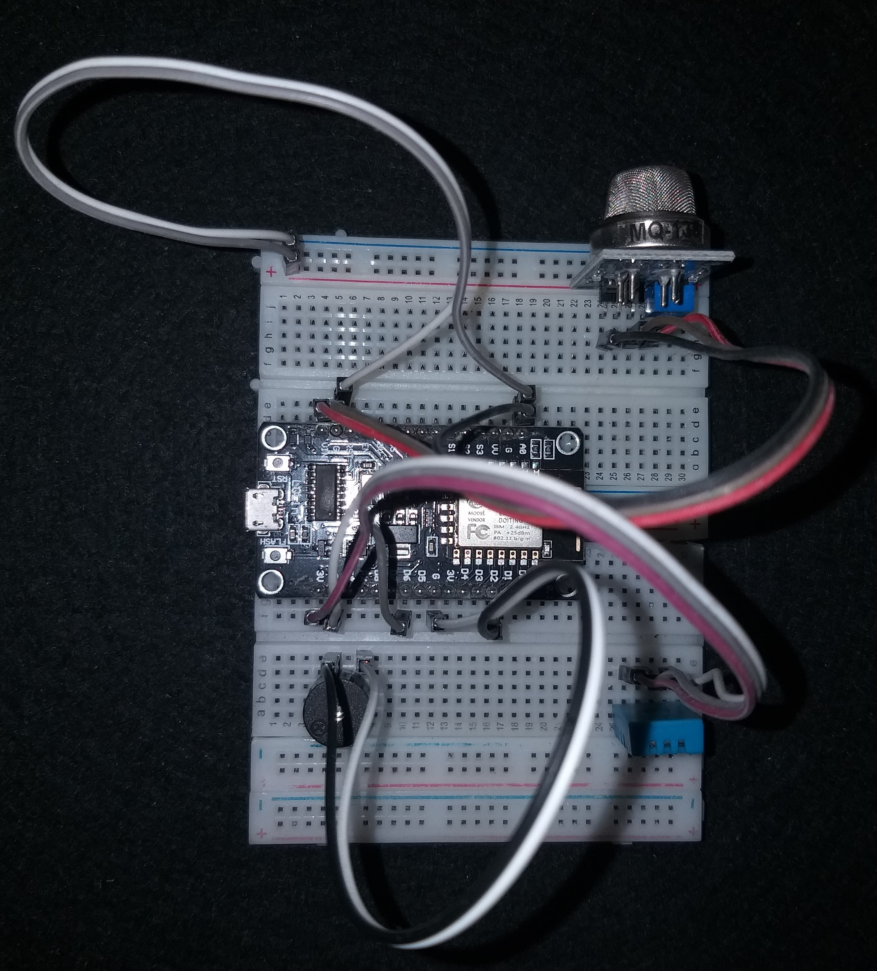
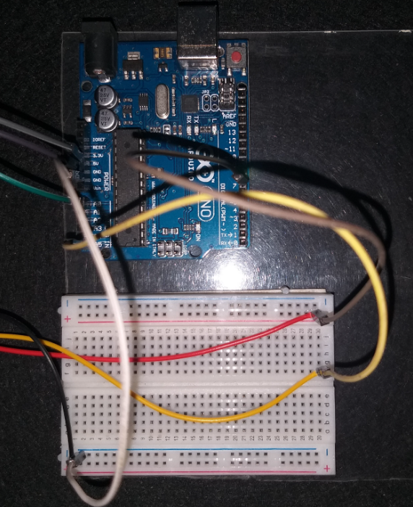
IAAS
SAAS
A. Openstack Cloud Platform
PAAS
1. Infrastructure
2. Backend (Managed, Configure)
B. ex1: Openstack Cloud Platform
C. ex1: Google Cloud Platform
https://github.com/Deshan555/IOT-Smart_Farming
Notes:
https://www.opensourceforu.com/2023/07/building-a-private-cloud-using-openstack/
https://embracingtherandom.com/deep-learning/cloud/gcp-deep-learning-vm/
https://www.youtube.com/watch?v=mZsdm9mRc94

Slide 15
Open Tofu for IaC
Notes:
https://opentofu.org/docs/intro/install/docker/

Slide 16


Infrastructure as a Code-IaC
Notes:
https://www.f5.com/glossary/infrastructure-as-code-iac
https://www.f5.com/products/big-ip-services/big-ip-automation-toolchain

Slide 17

Infrastructure as a Code-IaC
software-defined data center (SDDC) that enable DevOps implementation :
On-Demand Programmatic Provisioning
Using the APIs
Access and Collaboration
Parallelized Operations
Visibility and Control
Notes:
https://thecustomizewindows.com/2016/05/infrastructure-as-code-and-software-defined-data-center/#google_vignette
https://www.f5.com/glossary/infrastructure-as-code-iac
https://www.f5.com/products/big-ip-services/big-ip-automation-toolchain

Slide 18

Infrastructure as a Code-IaC
Notes:
https://www.f5.com/glossary/infrastructure-as-code-iac
https://www.f5.com/products/big-ip-services/big-ip-automation-toolchain

Slide 19




Managing Infrastructure as Code (IaC) with Open Tofu - Open TofU-IaC
Tofu
AWS environment using OpenTofu:
VPC and Subnet Setup
Internet Gateway and Route Tables
Security Groups and IAM Roles
EC2 Instance Provisioning
S3 Bucket Integration
Notes:
https://spacelift.io/blog/what-is-opentofu
https://ecanarys.com/opentofu-future-of-infrastructure-as-code/
https://opentofu.org/docs/intro/install/docker/
https://www.f5.com/glossary/infrastructure-as-code-iac
https://www.f5.com/products/big-ip-services/big-ip-automation-toolchain

Slide 20
Container : Docker, Kubernetes
Notes:
https://opentofu.org/docs/intro/install/docker/

Slide 21



Container
Container : Docker, Kubernetes, OpenShift, and Istio
Notes:
https://blog.ordina-jworks.io/paas/2017/06/29/Openshift-an-introduction.html

Slide 22


Notes:
https://www.redhat.com/en/blog/multiple-deployment-methods-openshift

Slide 23


Microservices with Docker and Kubernetes
Notes:
https://www.opensourceforu.com/2018/05/microservices-with-docker-and-kubernetes-an-overview/

Slide 24


Container Orchestration
Notes:
https://medium.com/@jushijun/deploying-a-machine-learning-model-with-docker-and-kubernetes-on-google-cloud-platform-21280db82840
https://www.f5.com/glossary/kubernetes

Slide 25


Kubernetes and Docker container with OpenTofu
Microservices, Docker and Kubernetes
Kubernetes uses Docker to run images and manage containers. Nevertheless, Kubernetes can use other engines, for example, rkt from the CoreOS. In general, Kubernetes is an easier-to-configure, more mature and functionally rich analog to the Docker Swarm. Docker, and other container systems, have made it easier to deploy microservices systems
Kubernetes Containerd Integration
Notes:
https://thecustomizewindows.com/2019/04/what-is-the-relationship-between-microservices-docker-and-kubernetes/#google_vignette
https://thecustomizewindows.com/2017/07/container-virtualization-growing-challenges/

Slide 26



Kubernetes Cluster
Concepts:
Service
ClusterIP
NodePort
LoadBalancer
ExternalName
Ports
Service, Load Balancer, Ingress
Cloud Load Balancer
Notes:
https://www.ulam.io/blog/kubernetes-scratch#
https://kubitect.io/latest/examples/accessing-cluster/
https://bsdnet.github.io/posts/kubernetes-service-illustrated/
https://habr.com/ru/companies/oleg-bunin/articles/558900/
https://habr.com/ru/companies/oleg-bunin/articles/558900/

Slide 27
How to Limit CPU and Memory Usage in Docker Containers Efficient strategies to manage CPU and memory usage in Docker containers for optimal performance and stability. create memory, vcpu
create memory, vcpu, floating, storage
docker run --memory="512m" --memory-swap="1g" your_image_name
docker run --cgroup-parent=/docker your_image_name
services:
your_service_name:
image: your_image_name
deploy:
resources:
limits:
memory: 512M
Notes:
https://aws.plainenglish.io/create-a-scalable-aws-vpc-with-auto-scaling-load-balancer-hands-on-learning-ce3abe9916fa
https://aws.plainenglish.io/create-an-ec2-auto-scaling-group-and-application-load-balancer-using-the-aws-command-line-interface-ccfdb06d5513
docker container Configure the number of CPUs and memory with open tofu
Configure the number of CPUs and memory

Slide 28






Networking: Auto Scaling & Load Balancer on AWS VPC
How to configure Network
AWS VPC
-Public Subnets
-Internet Gateway
-Route Table
AWS EC2
-Autoscaling Group
-Load Balancer
-Target Group
-Launch Template
Notes:
https://aws.plainenglish.io/create-a-scalable-aws-vpc-with-auto-scaling-load-balancer-hands-on-learning-ce3abe9916fa
https://blog.devops.dev/how-to-limit-cpu-and-memory-usage-in-docker-containers-f956a658b0e9
https://aws.plainenglish.io/create-an-ec2-auto-scaling-group-and-application-load-balancer-using-the-aws-command-line-interface-ccfdb06d5513

Slide 29
The End
Thx

Slide 30

Kubernetes Cluster Deployments
Notes:
https://ajanthan-eliyathamby.medium.com/exploring-kubernetes-cluster-deployments-on-premise-azure-d55bc46be797

Slide 31


Notes:
https://ajanthan-eliyathamby.medium.com/exploring-kubernetes-cluster-deployments-on-premise-azure-d55bc46be797

Slide 32
Kubernetes docker container implementation Platform

Slide 33
1. Introduction to Cloud Computing
2. Cloud Computing Architecture
3. Cloud Service Models
4. Cloud Computing Platform/Provider
5. Infrastructure as a Code
6. Containers
7. Orchestration Containers
8. Cloud Provisioning
9. Cloud Provisioning Optimation
10. Containers Optimation
11. Monitoring and Managing Cloud Resource
12. Serverless Computing
Notes:
Implementasi sebuah jaringan server yang menyediakan layanan kompu tasi awan dan proses manajemen sumber daya komputasi awan berbasis Infrastructure as a Code. Pembahasan dalam kuliah ini akan difokuskan pada penggunaan aplikasi Docker sebagai Container, Kubernetes sebagai Orchestration, dan openTofu sebagai IaC

Slide 34
Docker Management and Kubernetes Orchestration Kubernetes Orchestration docker container implementation Docker Container, Orchestration kubernetes and IaC open tofu
Notes:
https://www.slideshare.net/slideshow/container-orchestration-with-docker-swarm-and-kubernetes/147250171
https://github.com/jpetazzo/container.training
Docker, containers, and orchestration.
For the moment, it includes:
Introduction to Docker and Containers,
Container Orchestration with Docker Swarm,
Container Orchestration with Kubernetes.
https://medium.com/developer-for-life/docker-management-and-kubernetes-orchestration-2b7baf60a704

Slide 35

Tofu, KuberNetes
Notes:
https://iosonounrouter.wordpress.com/tag/openstack/
https://iosonounrouter.wordpress.com/tag/openstack/

Slide 36
Open TofU IaC Open TofU -IaC - Infrastructure as a Code
Docker sebagai Container,
Kubernetes sebagai Orchestration,
openTofu sebagai IaC.
Docker Container, orchestration kubernetes and IaC open tofu

Slide 38
Kubernetes Minikube OpenTofu
Kubernetes Minikube OpenTofu
Minikube vs Kubernetes distro

Slide 39
Minikube Deployment and Automation OpenTofu Deployment
Minikube Deployment and Automation OpenTofu Deployment
Enhancing Nginx, Wordpress, and MariaDB with ConfigMaps, Secrets, and RBAC using OpenTofu
Rolling Updates and Rollbacks using OpenTofu for Kubernetes Deployments
Rolling Updates and Rollbacks using OpenTofu for Kubernetes Deployments

Slide 40
lab cloud infrastructure (compute, network, storages, neutron swift,Heat)
Notes:
https://docs.openstack.org/liberty/install-guide-rdo/overview.html
https://docs.openstack.org/liberty/install-guide-rdo/overview.html

